Slide 1
Desertscape Simulation - Grid Enrichment
Anant Kumar & Shivam Sood
Notes:
Our Notes: https://docs.google.com/document/d/1qtn2TLVdPid-1VOqTJHchLQVPqxbiyr35dxob3cle74/edit?usp=sharing

Slide 2
Agenda
Background
Original Paper : Desertscape Simulation
Our Approach
Retracing time steps
Quadtrees for Local Refinement
Demo
Future Work

Slide 3
Background

Slide 4
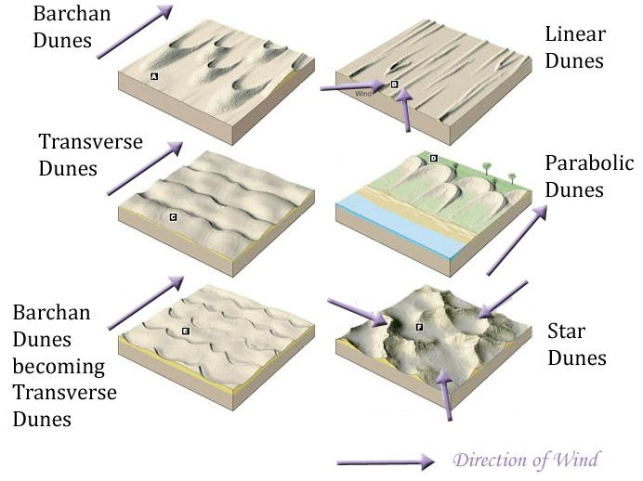
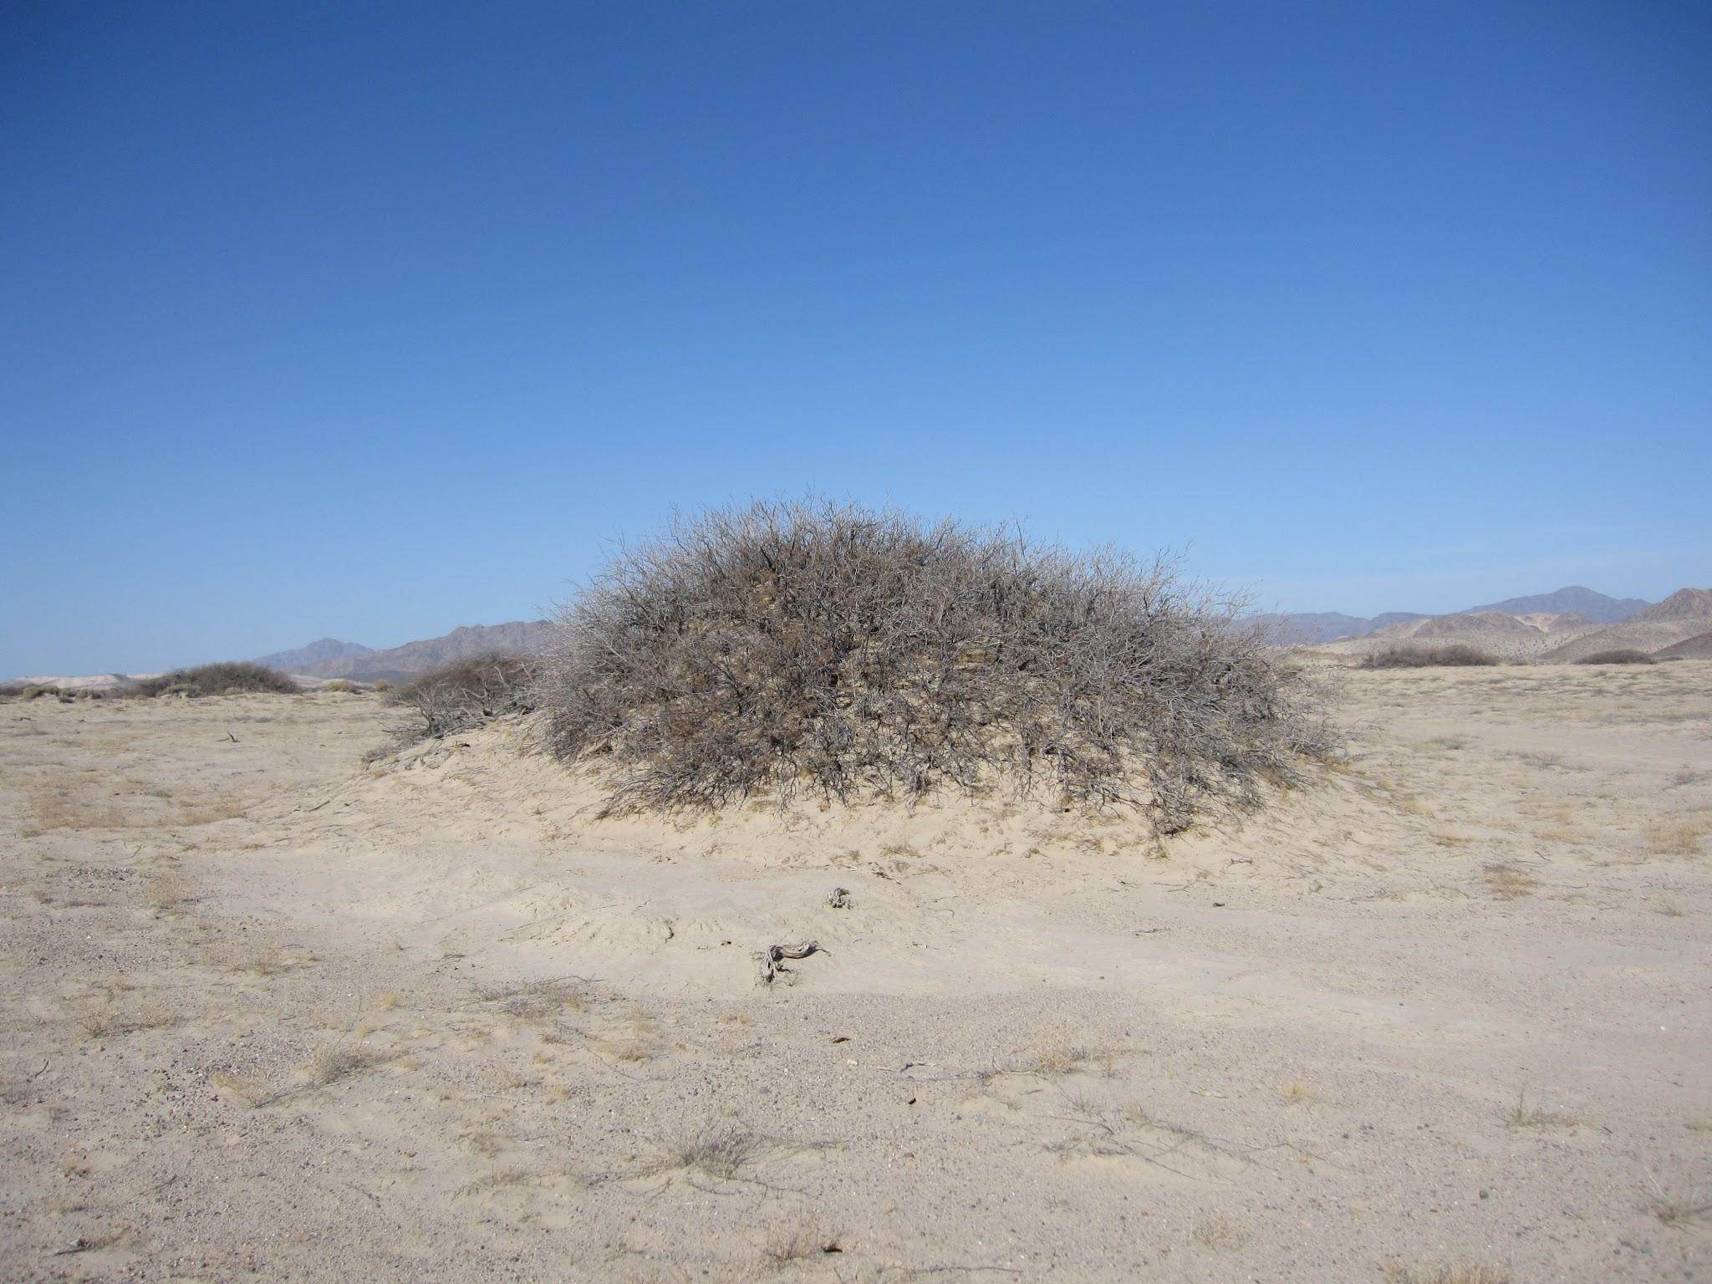
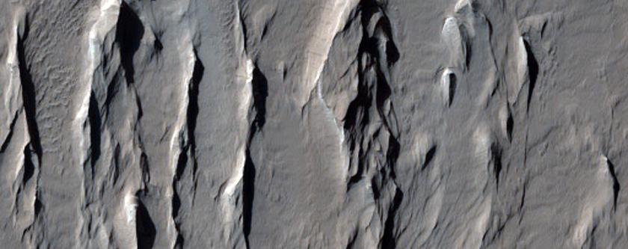
Desert Landscapes
Nabhka
Yardang
Notes:
Nabhka: a sand dune that forms around vegetation.
Yardang is a streamlined protuberance carved from bedrock or any consolidated or semiconsolidated material by the dual action of wind abrasion by dust and sand, and deflation which is the removal of loose material by wind turbulence.

Slide 5
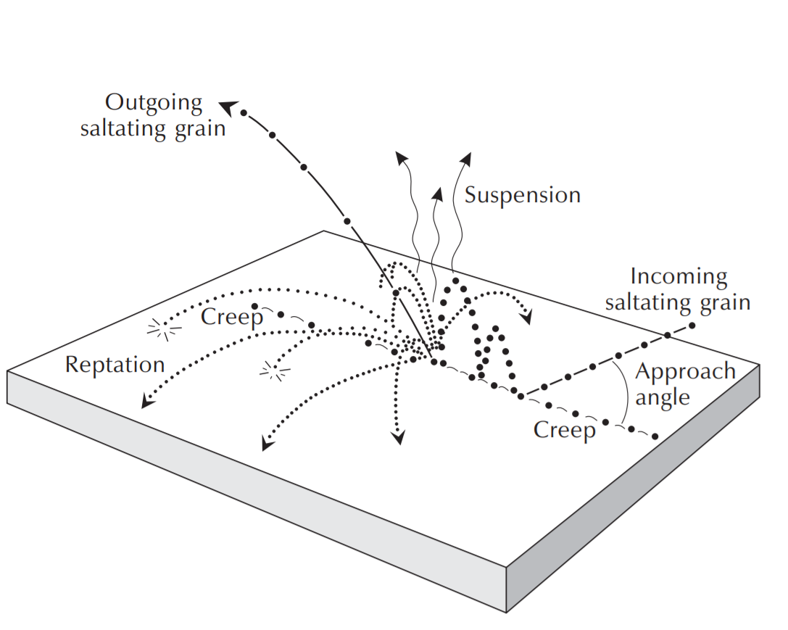
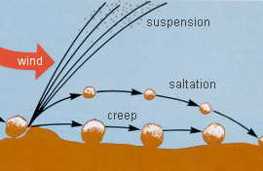
Modes of Grain Transport by Wind

Slide 6
Desertscape Simulation
Axel Paris, Adrien Peytavie, Éric Guérin, Oscar Argudo, Éric Galin
https://aparis69.github.io/public_html/projects/paris2019_Deserts.html

Slide 7
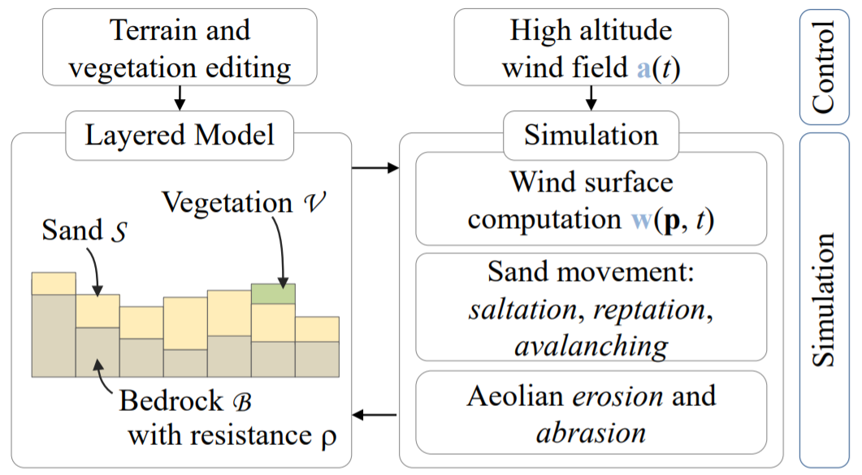
Overview of the Approach
Notes:
Abrasion is a process of erosion which occurs when material being transported wears away at a surface over time.

Slide 8
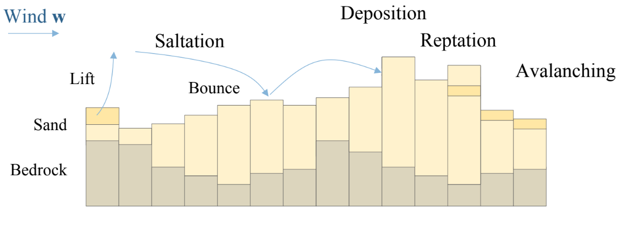
Modelling Transport Phenomena

Slide 9
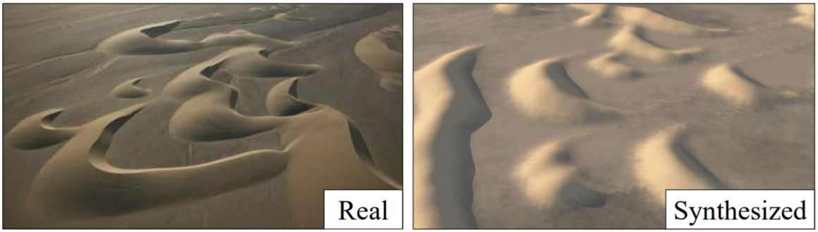
Limitations
Grid cell ~ 10m

Slide 10
Our Approach

Slide 11
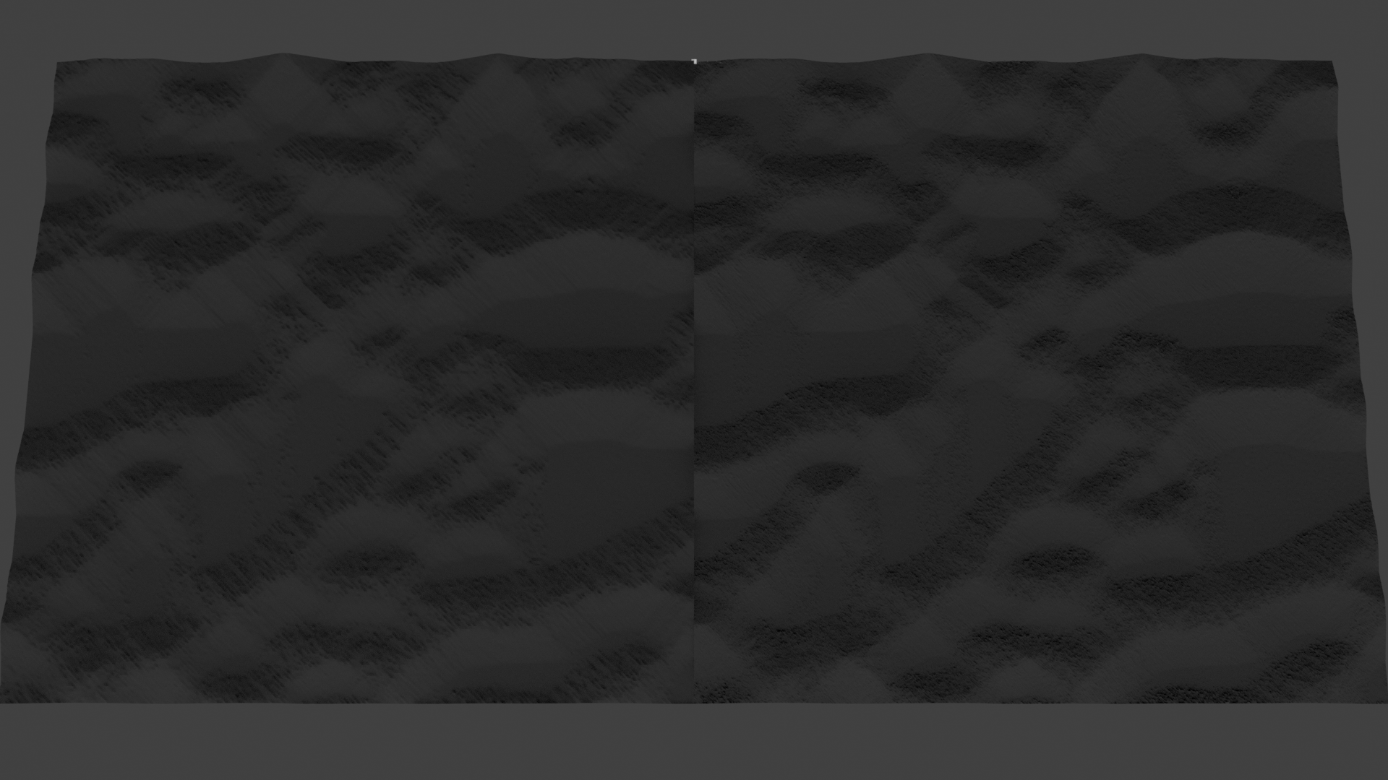
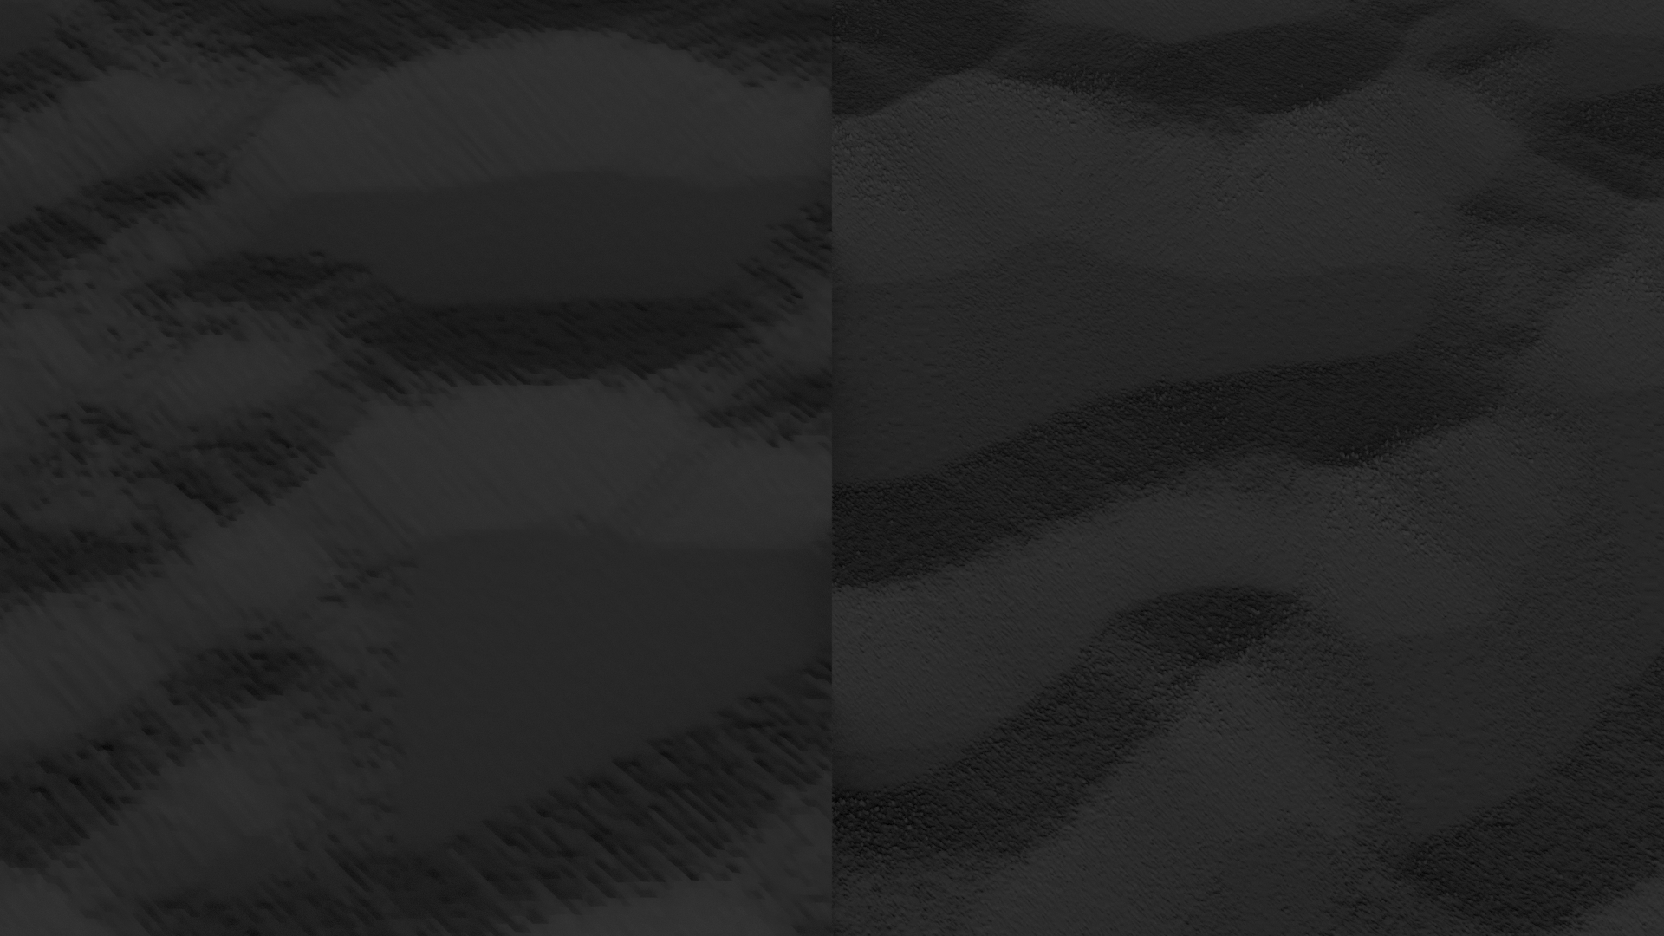
Increased Resolution in Last Steps
Same Coarse Structure with Finer Details:
But what is the last time step?

Slide 12
Tracking Back Snaps
Overload Constructor
Queue Copies
Fetch History
Retrace
Generate a new dune object from an existing one (snapshot).
Maintain a queue of copies of the dune - FIFO.
(Length decided by user)
User specified simulation end.
Fetch oldest copy from queue.
Copy of dune with
Subdividing factor>1
and
Rerun last few steps.

Slide 13
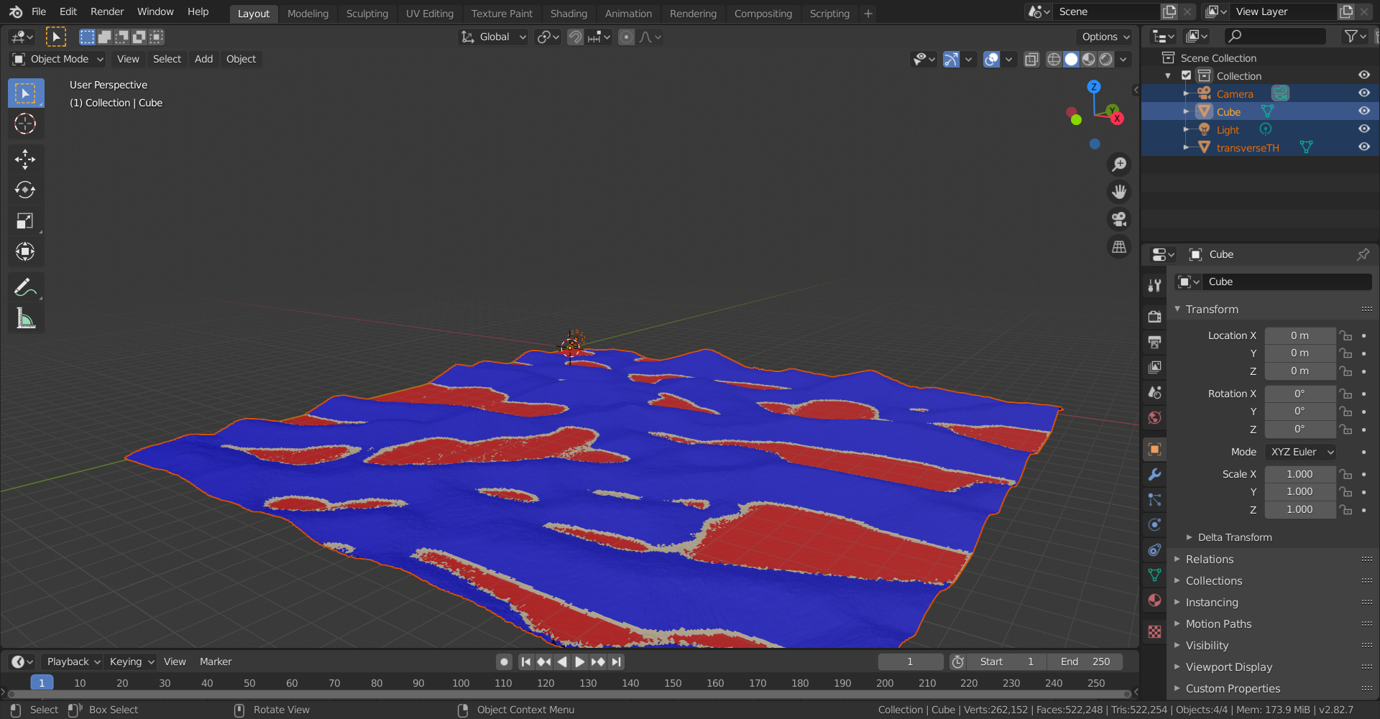
Coloring Mechanism

Slide 14
Quad tree(s)
Features | Changes
Queries for fetching: Leaves Neighbours Bounds CellData corresponding to point Separate CellData object - only for a leaf roots[nx][ny] for random access | Gradient Computation Mesh Generation Saltation, Reptation, Avalanching, abrasion Every other function accessing the grid. (Most of the simulation!)

Slide 15
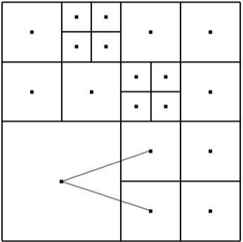
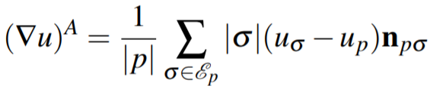
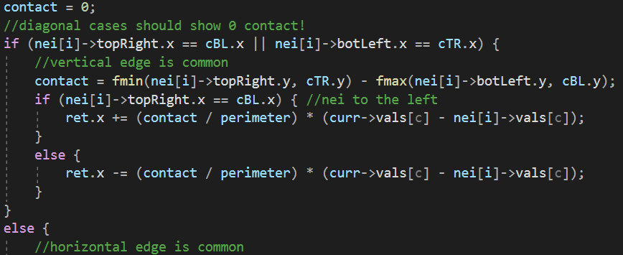
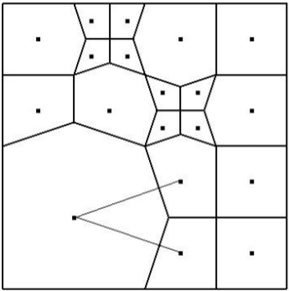
Gradients
Notes:
https://www.math.sk/mikula/khm_fvca7.pdf

Slide 16
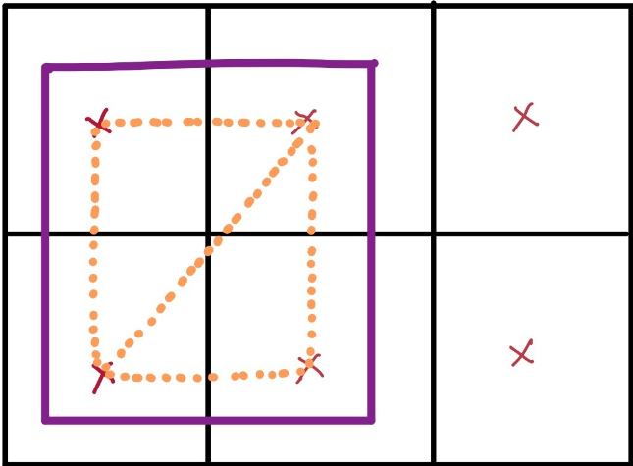
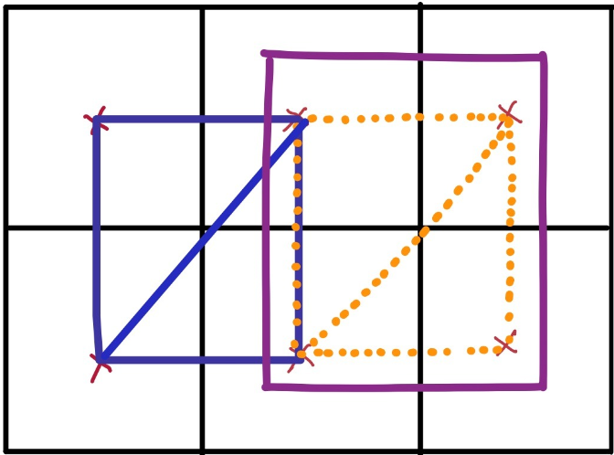
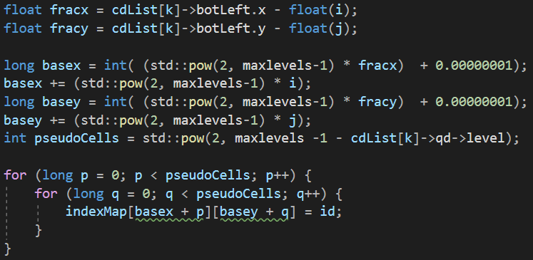
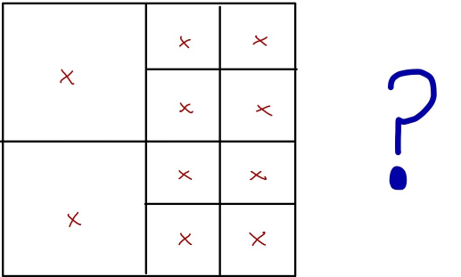
Mesh Generation

Slide 17
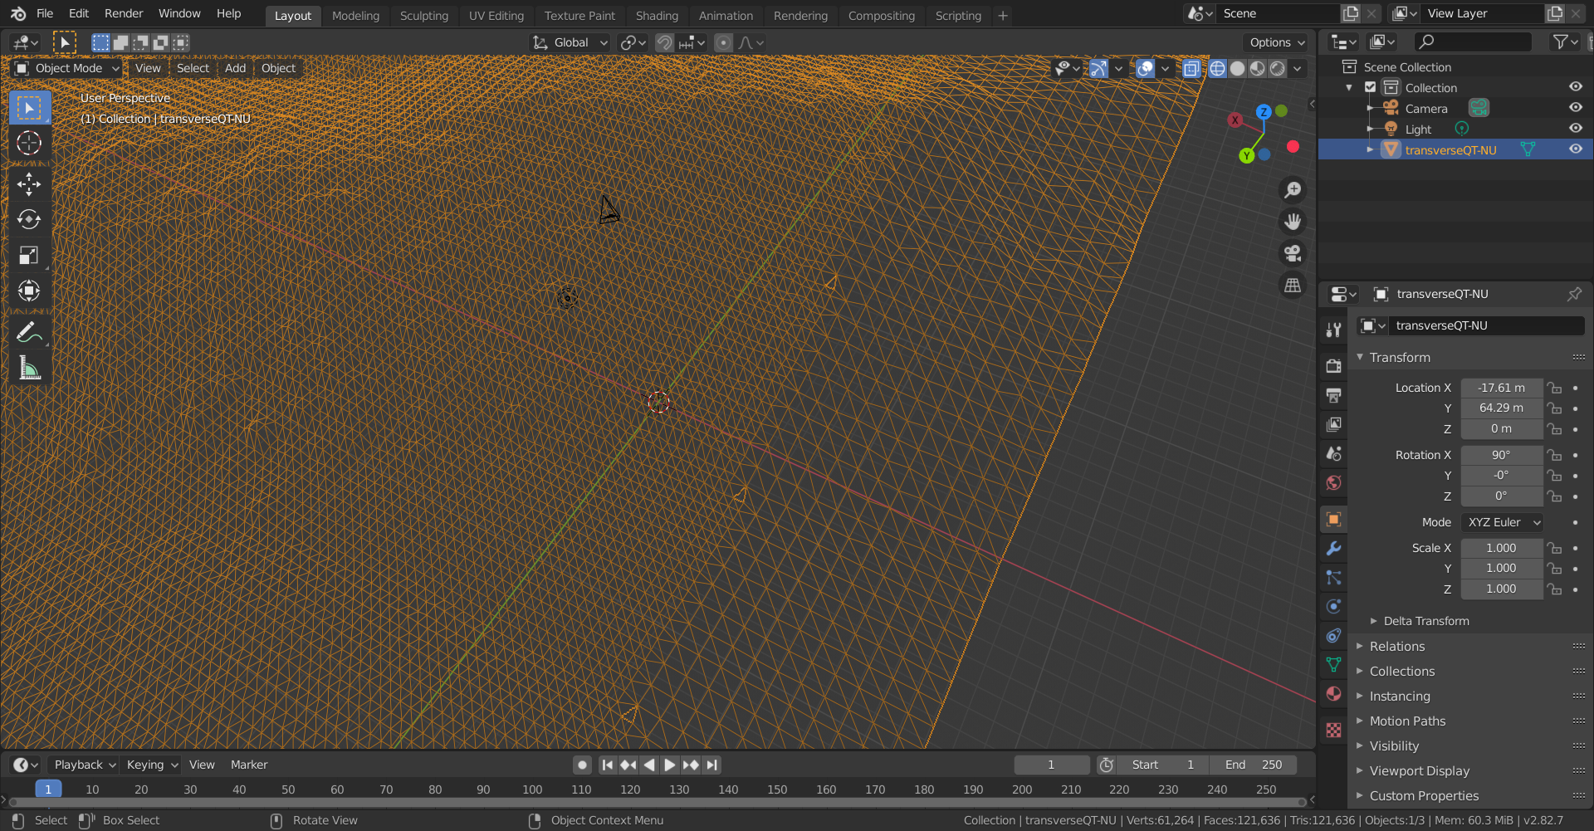
Query Callback for NU Mesh

Slide 18
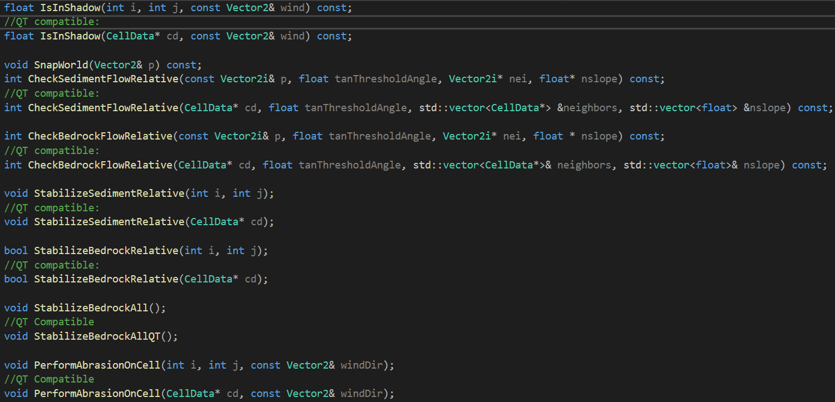
Other Modifications

Slide 19
Demo

Slide 20
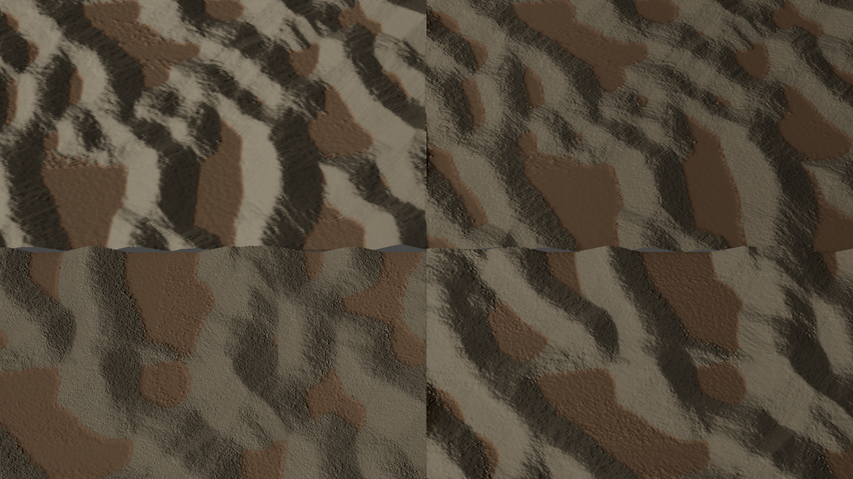
Results
High Sediment Regions Optimized with Quad-trees
Original
256x256
Resolution Doubled + Optimized with Quad-tree
Resolution doubled at last 10 time steps
Notes:
Cycles:
TL: 256X256

Slide 21
Future Work
Impact of Resolution on Thresholds
Automatic Query Synthesis
Generalization to other erosion models
Optimized Implementation
Other Grid Types

Slide 22
Acknowledgements
Prof. Parag Chaudhuri for providing us with direction and considerate supervision.
Authors: Axel Paris, Adrien Peytavie, Éric Guérin, Oscar Argudo, Éric Galin - for their exceptional work on which we could build upon.
Teachers and fellow students for help that is hard to delineate but impossible to deny.

Slide 23
Thank you!

